Slide 1
Track & Field Meet Server
Phase 1 Presentation
Tracy Marshall

Slide 2
Agenda
Project Overview
Project Requirements
Project Plan
Cost Estimation
Architecture Elaboration Plan
Software Quality Assurance Plan
Risks
Alpha Prototype Demonstration
Questions and Comments

Slide 3
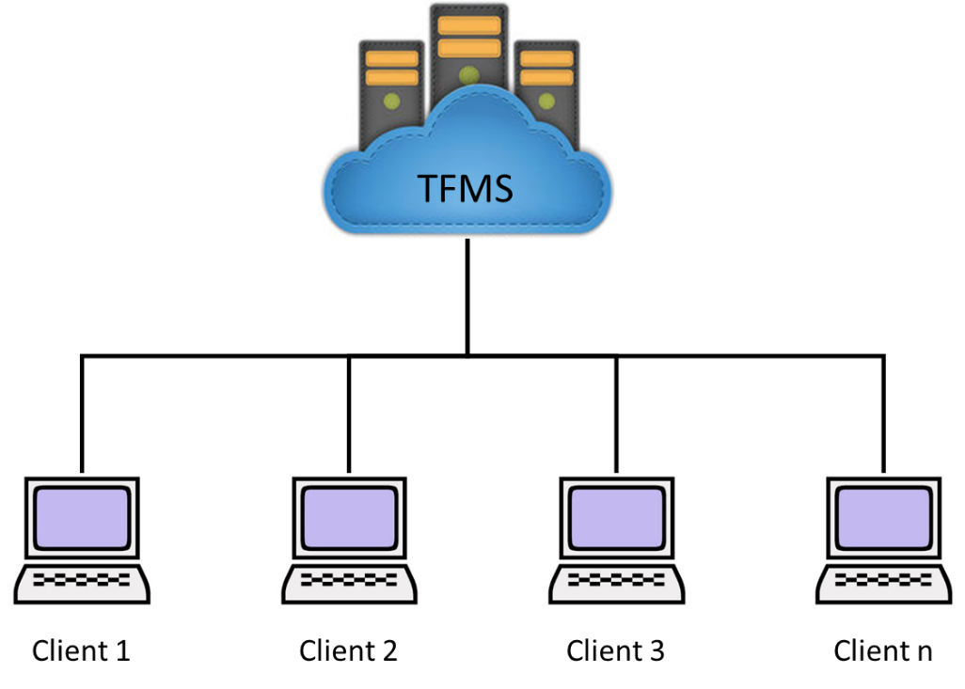
Project Overview
Track & Field Meet Server
Capability to support function of hosting a Track Meet
Repository for all meet data
API to add, manipulate, and view data
Unique user classifications
Supports authentication and encryption to prevent tampering of data

Slide 4
Project Overview
Goals
Create a fully functional server that supports clients of different user classifications
Create a rich API that gives developers the ability to create functional client applications
Create a system that is safe from malicious attackers, attempting to manipulate meet results
Motivation
Leverage today’s technology to increase the efficiency of track meets
Provide a framework that can be built on to advance the future conduct of track meets

Slide 5
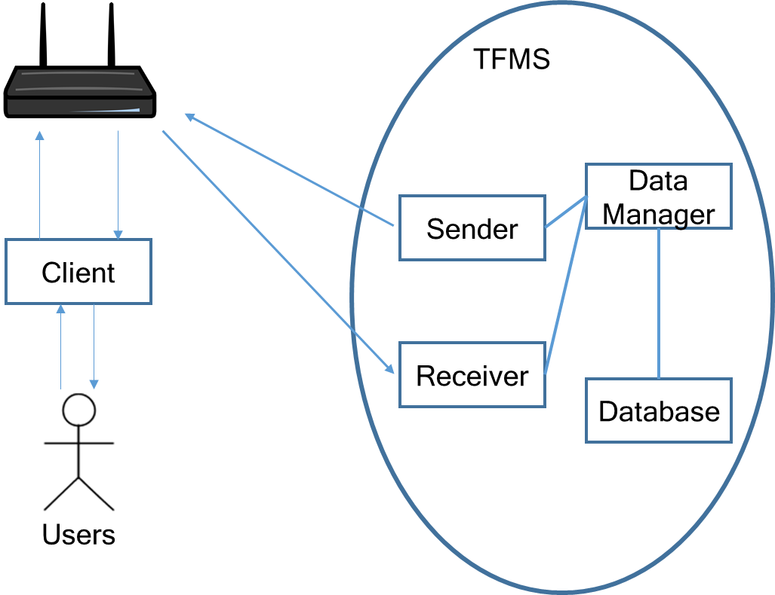
Project Overview

Slide 6
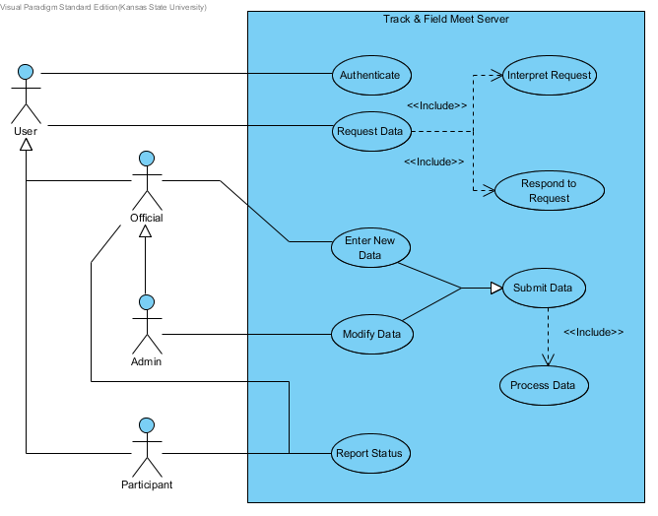
Project Requirements

Slide 7
Project Requirements
SR1.1 The system SHALL authenticate users with each interaction they have with the system.
SR2.1 The system SHALL receive data requests from concurrent users.
SR3.1 The system SHALL interpret user requests based on the API.
SR4.1 The system SHALL send response messages to the users.
SR5.1 The system SHALL receive data submittals from official and admin users based on the API.
SR6.1 The system SHALL put submitted data into the system.
SR7.1 The system SHALL add data to the system that is submitted by officials.
SR8.1 The system SHALL modify data in the system that is submitted by administrators.
SR9.1 The system SHALL store a status that is reported by a participant or official.

Slide 8
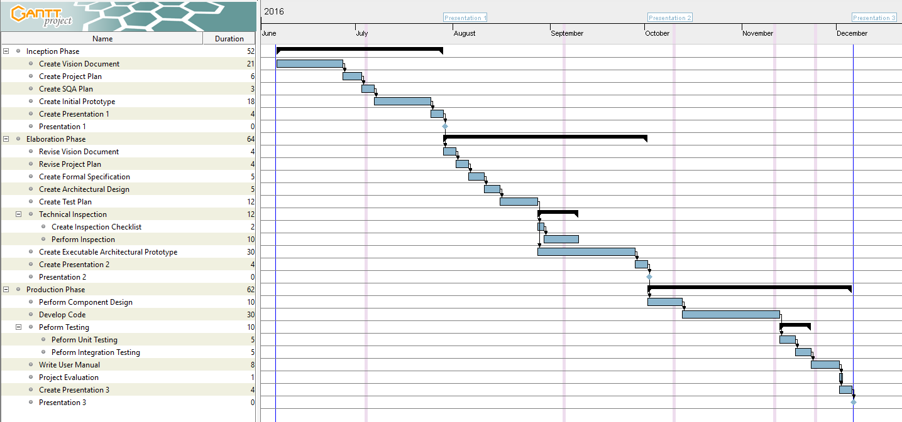
Project Plan

Slide 9
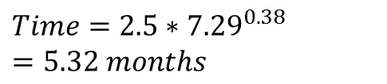
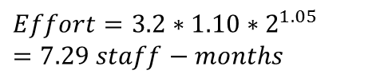
Cost Estimation
Using COCOMO
$$Effort=3.2∗1.10∗2^{1.05}=7.29 staff−months$$
$$Time=2.5∗{7.29}^{0.38}=5.32 months$$

Slide 10
Architecture Elaboration Plan
Revise Vision Document
Revise Project Plan
Create Formal Specification
Create Architectural Design
Create Test Plan
Conduct Technical Inspection
Create Executable Architecture Prototype

Slide 11
Software Quality Assurance Plan
Management
Documentation
Standards, Practices, Conventions, and Metrics
Software Reviews
Testing
Problem Reporting
Tools, Techniques, and Methodologies
Media Control
Risk Management

Slide 12
Risks
Demand on server is not well understood
Performance of Raspberry Pi isn’t full realized
Authentication and Encryption mechanism is not fully determined

Slide 13
Alpha Prototype Demonstration
GitHub Repository Location:
https://github.com/ttmarshall12/KSUMSE
Worked on server/client communication
Explored encryption and authentication models to mitigate risk into development
Able to encrypt and authenticate data sent between server and client

Slide 14
Questions and Comments

